Slide 1
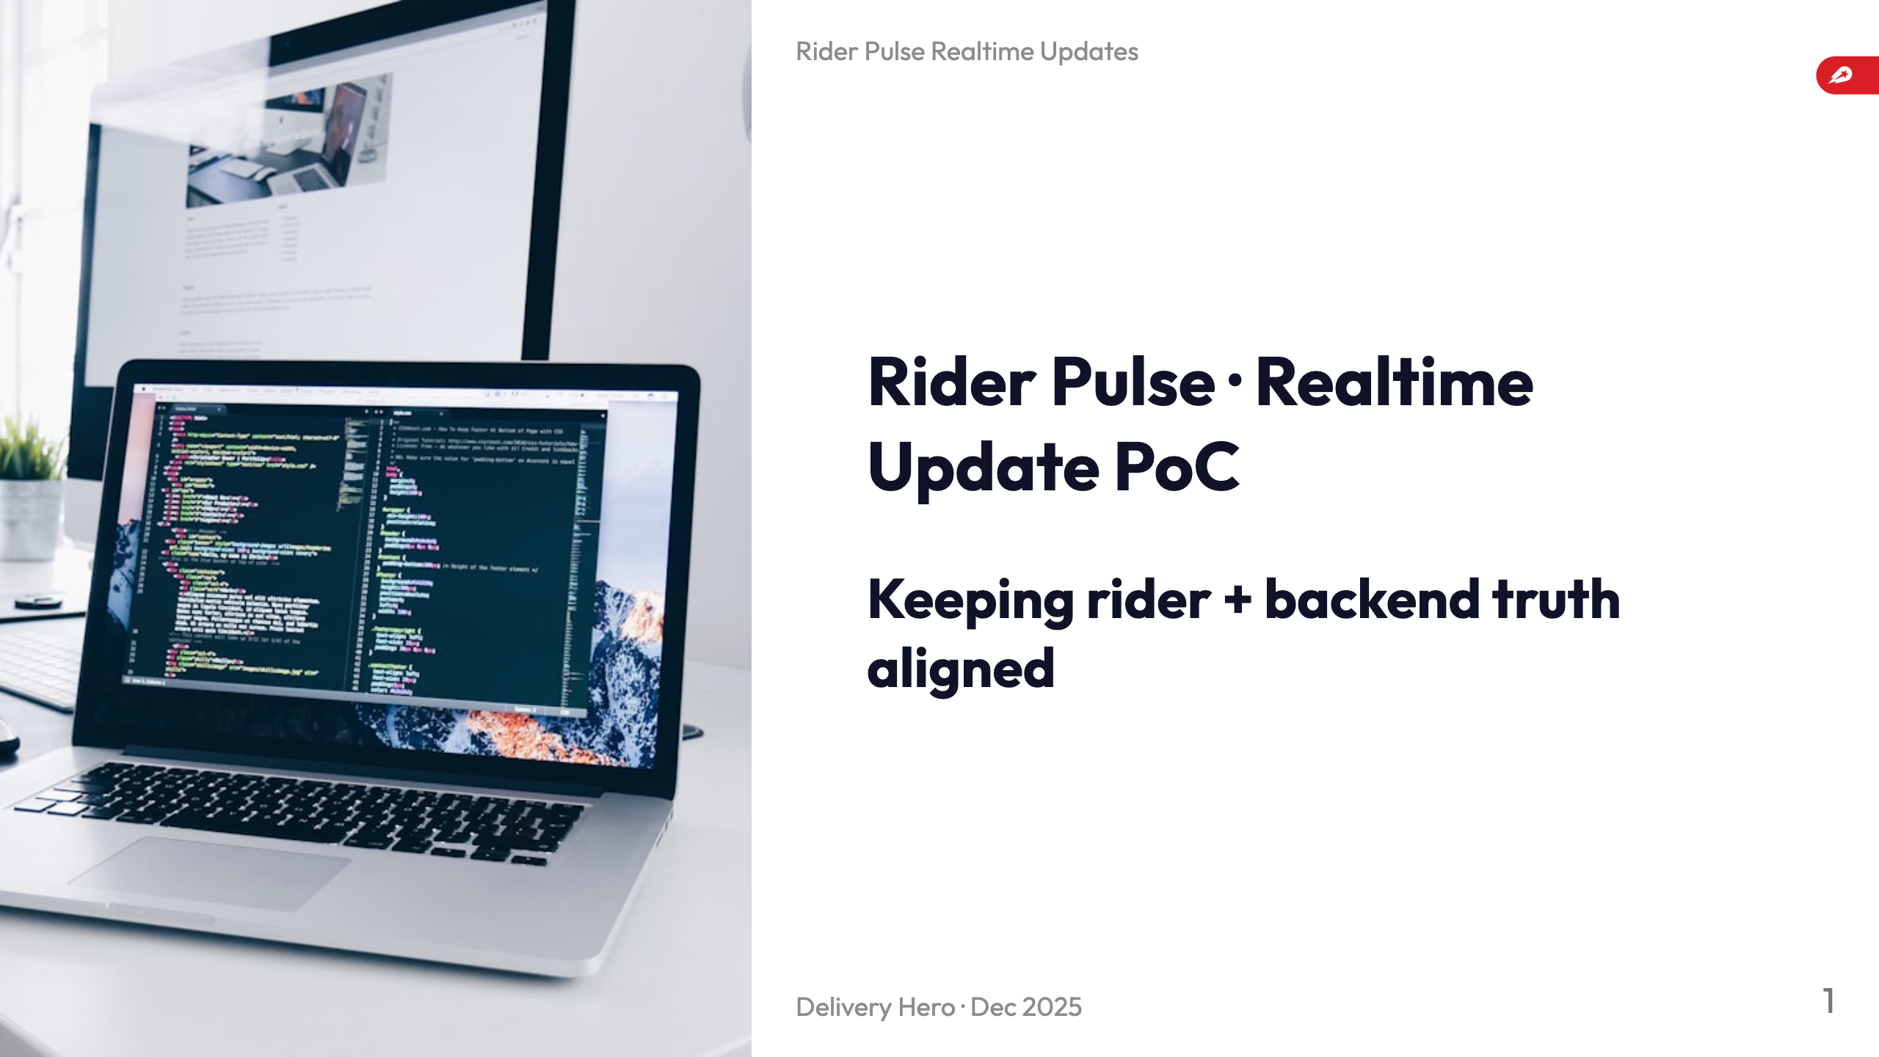
Notes:
- Set context: Rider Pulse project aiming for realtime parity between backend and device. - Mention PoC proves new modality for shift/orders/payout freshness. - Highlight agenda: problem, solution, results, next steps.

Slide 2
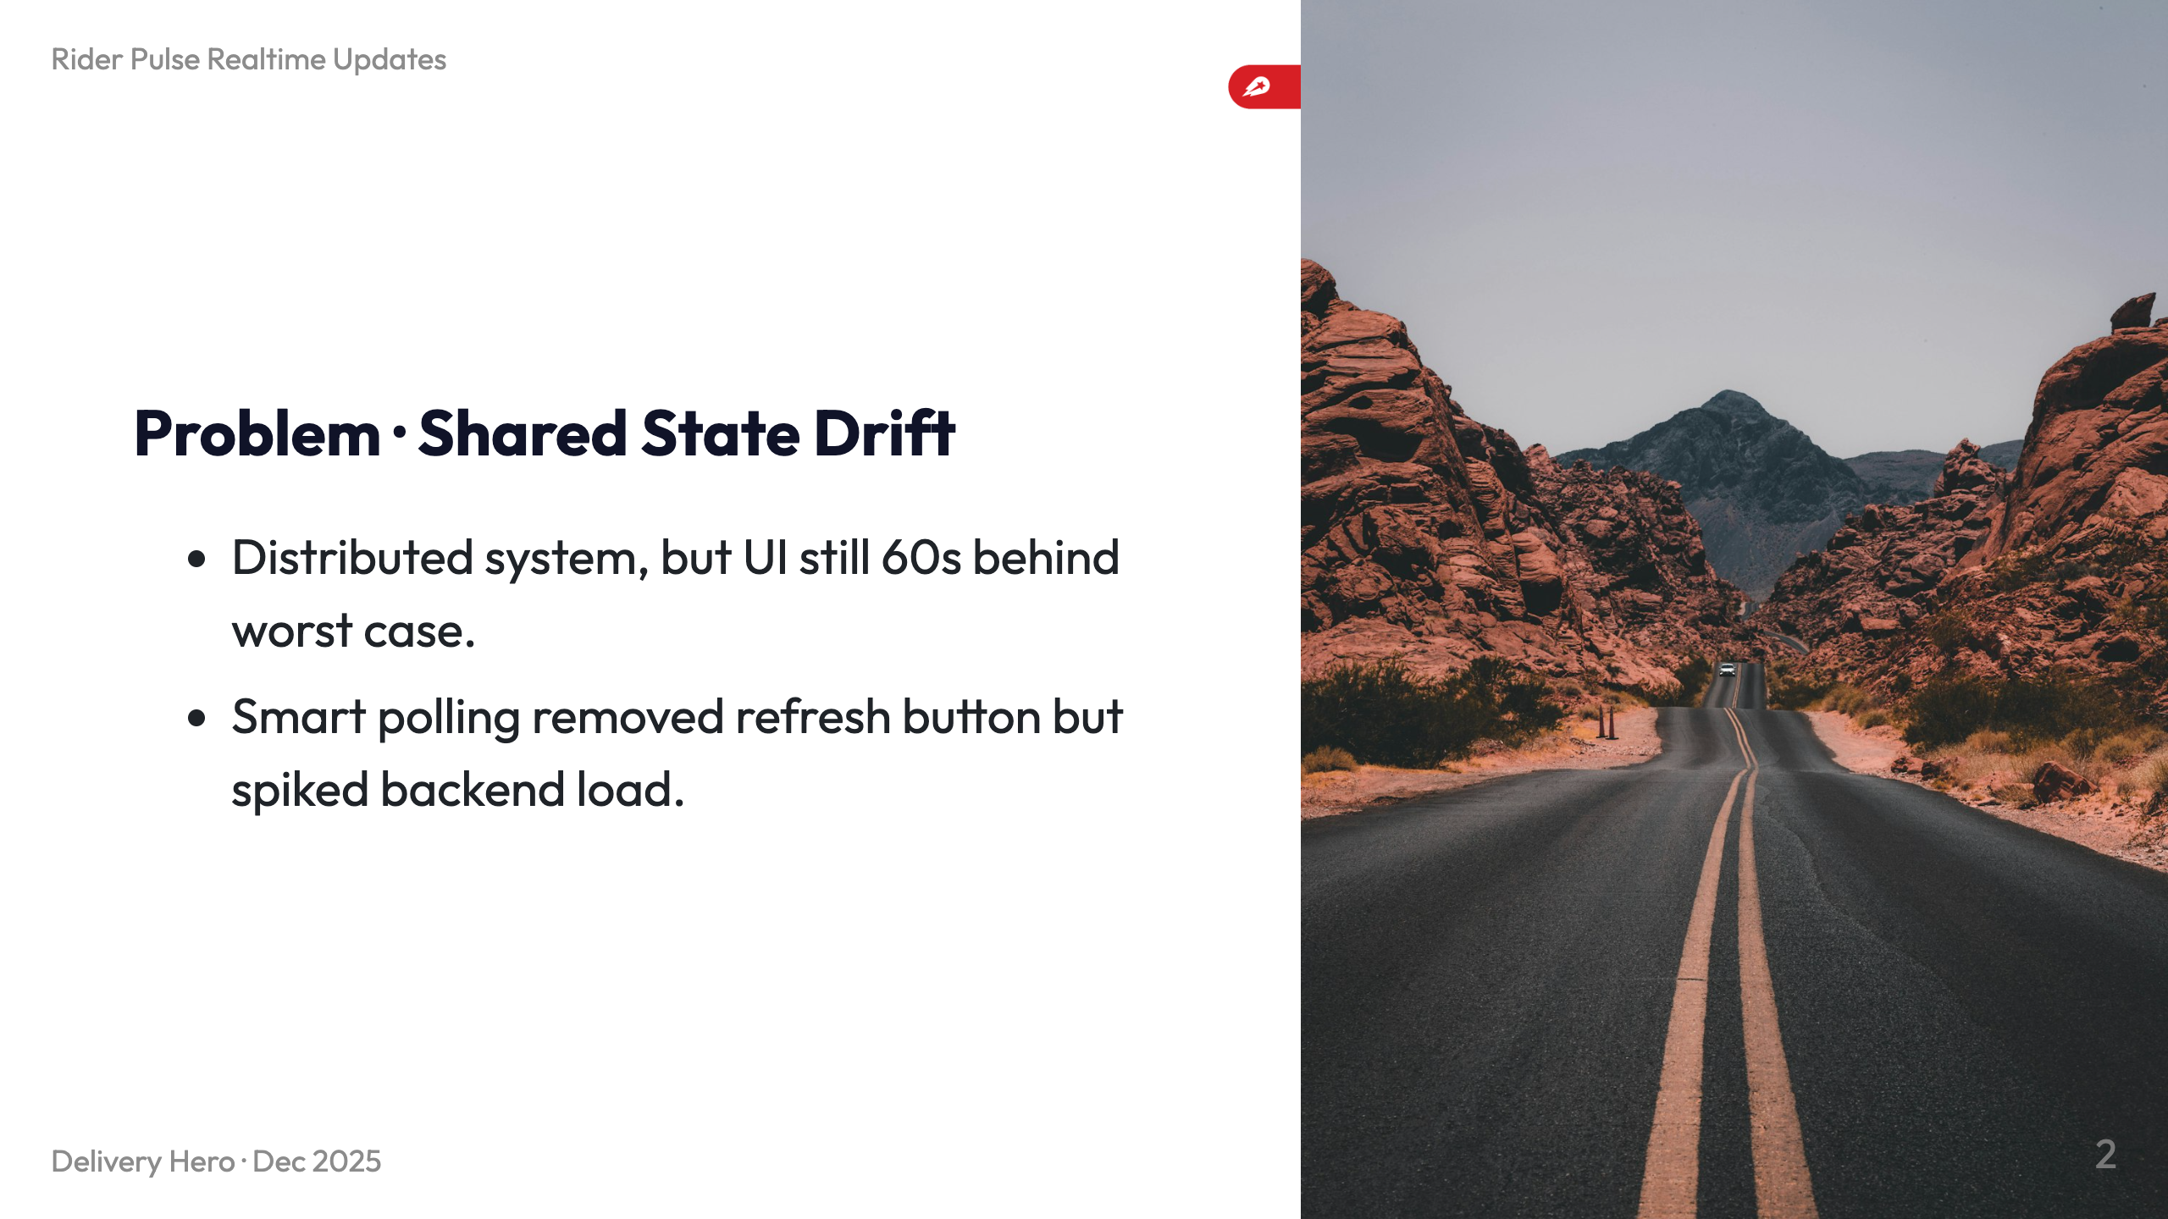
Notes:
- Riders rely on split cloud/device state; RFC stresses always-fresh data. - Poll interval 60s after each update—drift happens if change lands post poll or rider goes offline. - Removing manual refresh increased backend calls ~66% yet did not solve support/RSAT complaints.

Slide 3
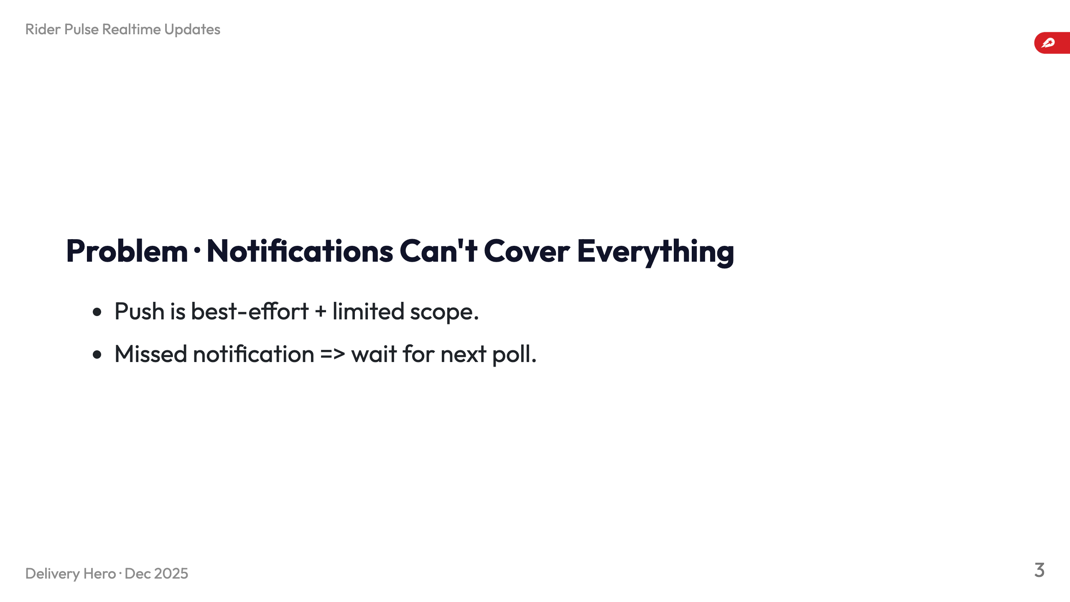
Notes:
- Can't notify every mutation: sensitive payouts, interim routing, background-only cases. - Apple throttling causes gaps; cancellations, stacked orders, PUDO, idle-state payouts drift. - Lost push today means riders wait for polling, hurting acceptance time + “delivery not seen” metrics.

Slide 4
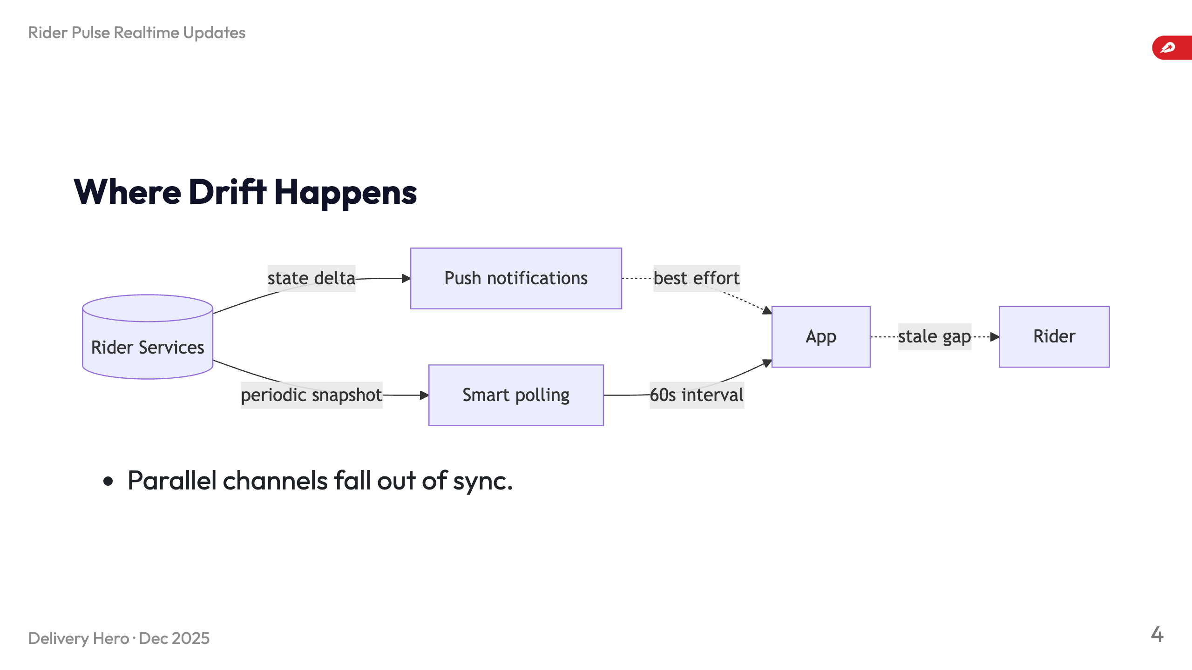
Notes:
- Push path and polling path have different reliability guarantees; either can fail silently. - When either slips, riders wait up to 60s; stacked deliveries magnify inconsistency between backend timeline and device timeline.

Slide 5
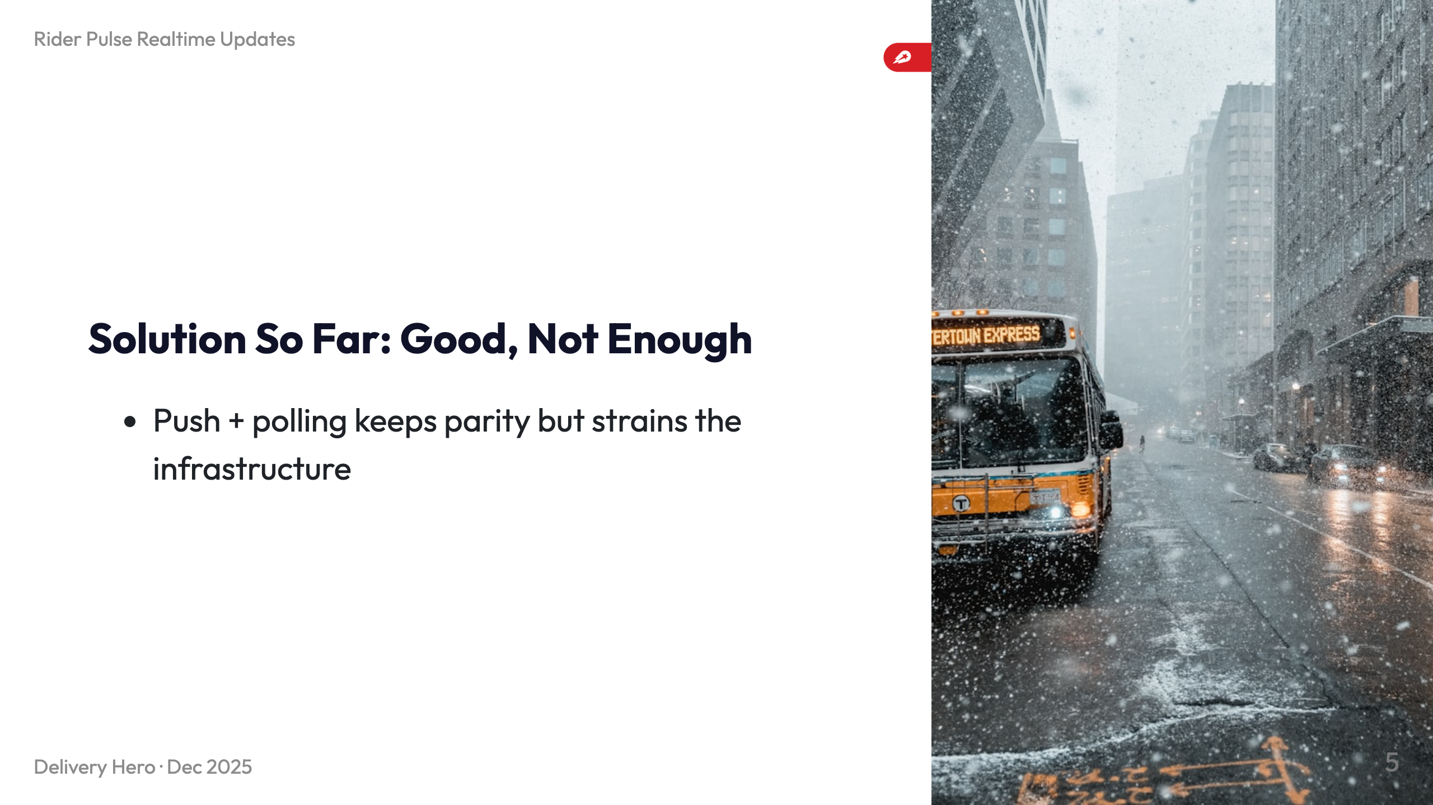
Notes:
- Push triggers RiderHome refreshes yet depends on APNS and device connectivity. - Smart polling fetches whole state on launch + every minute; ensures eventual consistency but costs compute/bandwidth. - Together they still allow 60s drift and increase backend load, not scalable.

Slide 6
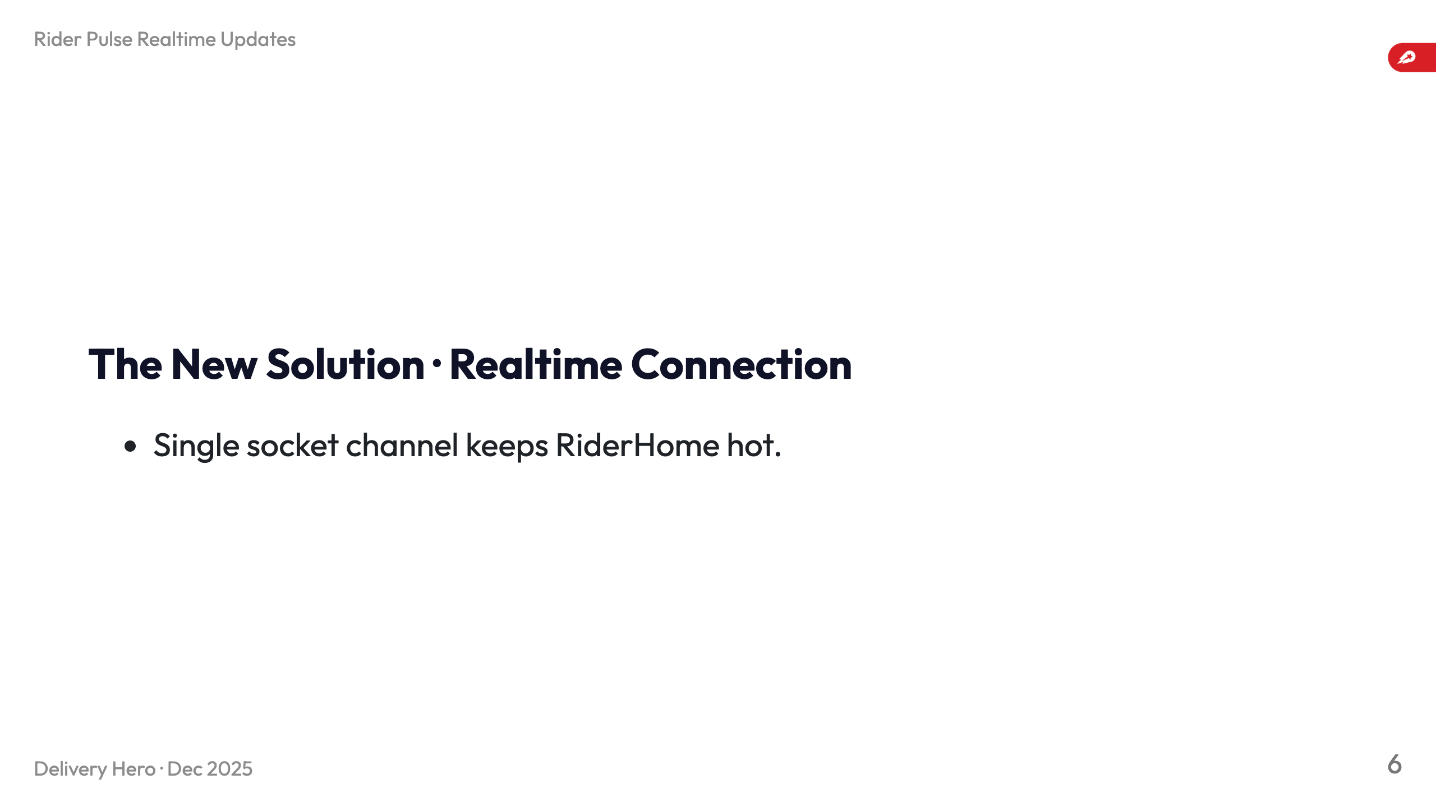
Notes:
- WebSocket streams incremental state, no more “wait for next poll.” - `Realtime.ConnectionManagerImpl` manages client state, auth tokens, lifecycle, messages, reachability. - Messages trigger `RiderHomeDataService.refresh(trigger: .socketEvent)` for near-immediate UI updates.

Slide 7
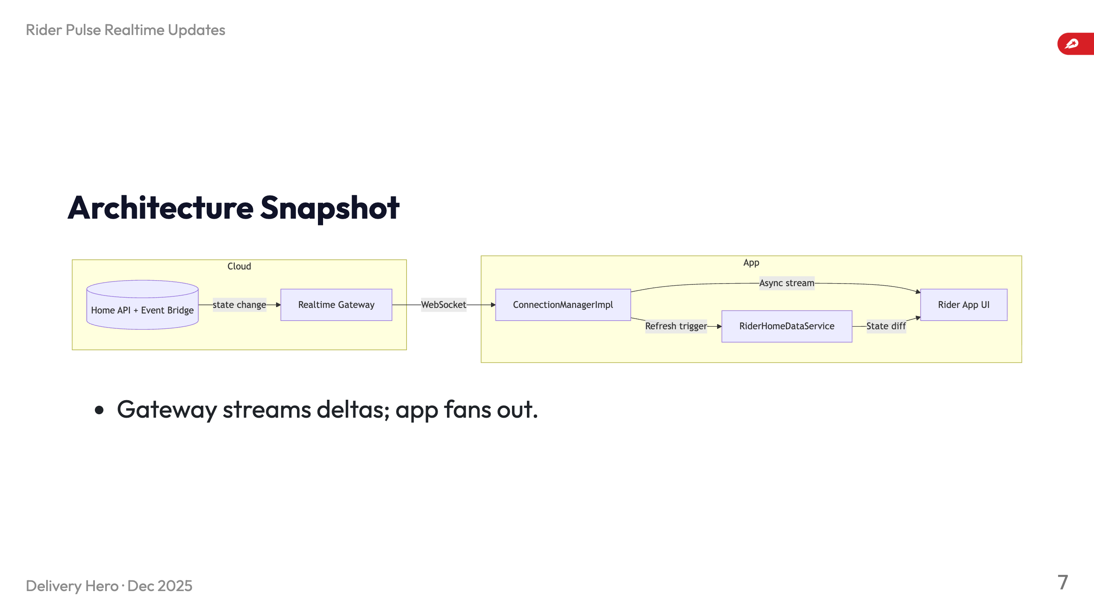
Notes:
- Backend emits state deltas to Realtime Gateway; socket feeds `ConnectionManagerImpl`. - Manager republishes via `AsyncMulticastStream<ConnectionState>` and triggers RiderHome refreshes. - Absence of deltas is detectable immediately, letting us react fast.

Slide 8
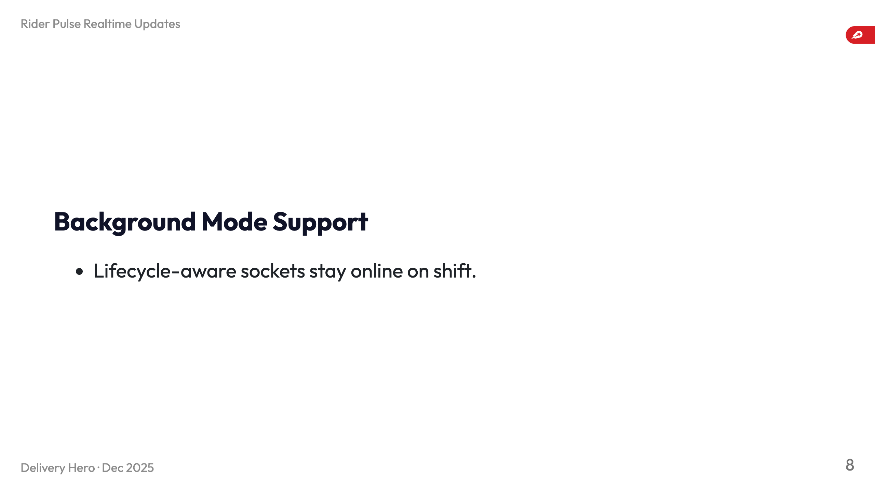
Notes:
- `AppStateObserver` lets us keep socket alive in background during navigation/camera tasks. - Foregrounding sets reconnect delay to foreground value and reuses cached token for instant restore. - Covers scenario where rider accepts order while hopping apps (Acceptance + OTW requirement).

Slide 9
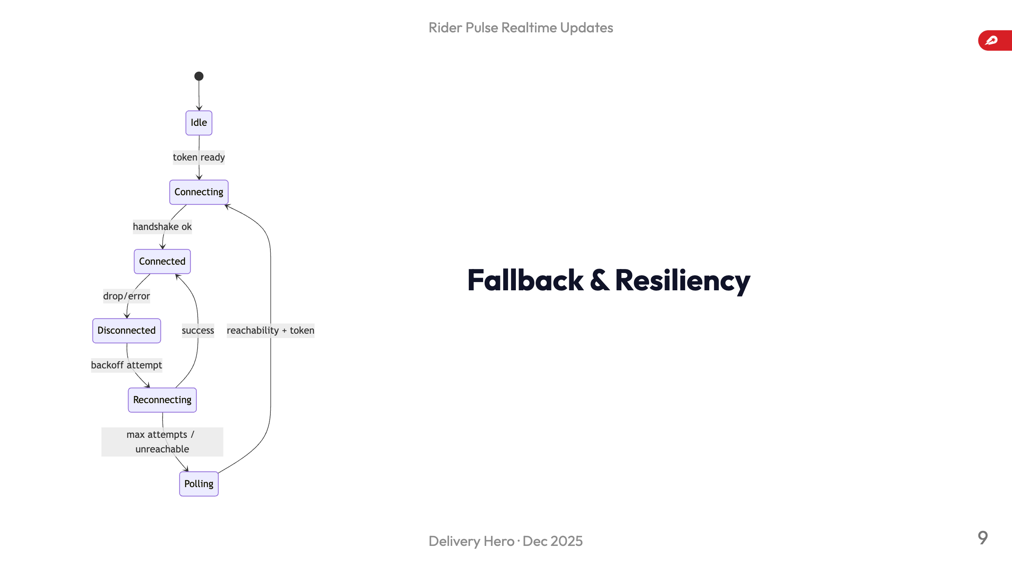
Notes:
- Exponential backoff with reachability gating prevents thrashing when offline. - After `maxReconnectAttempts` we fall back to smart polling; `stateValidityManager.invalidateState(.other)` marks data stale. - Riders offline still get consistent data; online riders snap back to realtime once socket recovers.

Slide 10
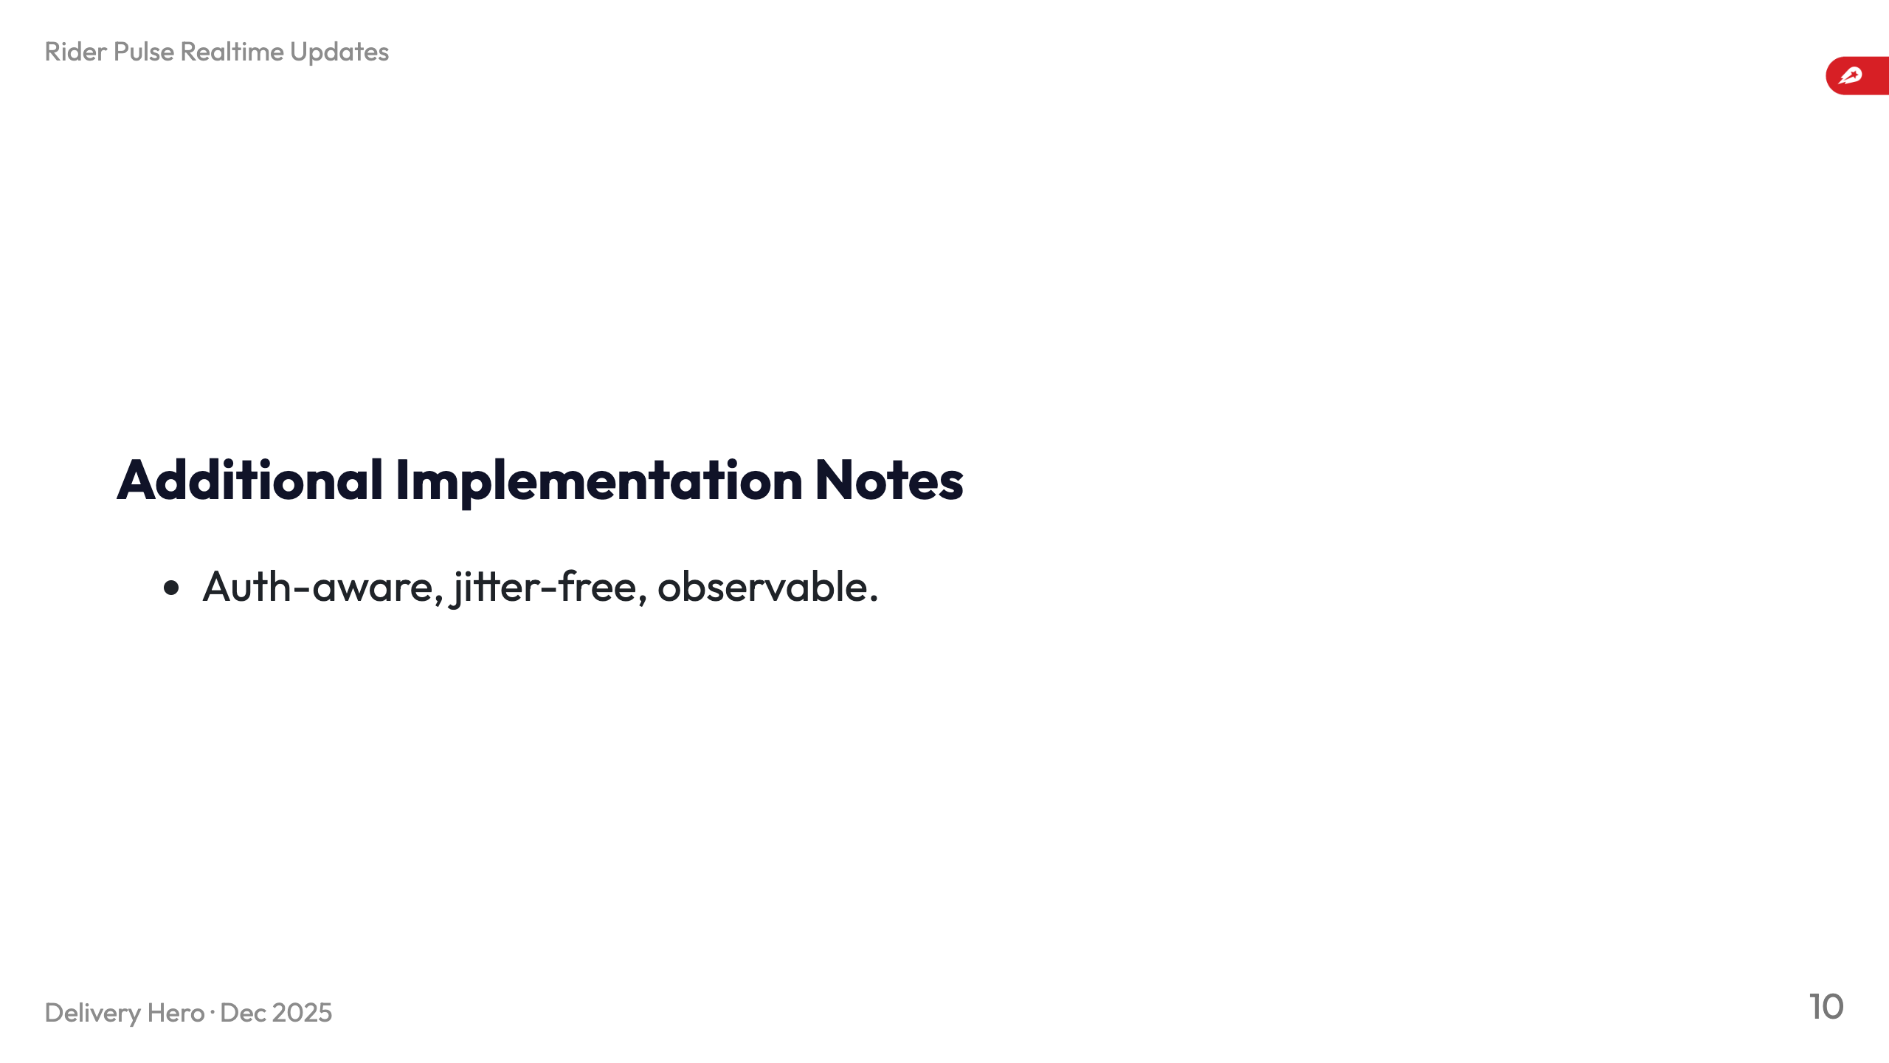
Notes:
- Manager watches token refreshes and reauthenticates without disconnect storms. - Message receipts reset reconnect delay to avoid jitter when traffic is sparse. - `debugConfigurationSnapshot()` exposes config/backoff/background details for QA without rebuilds.

Slide 11
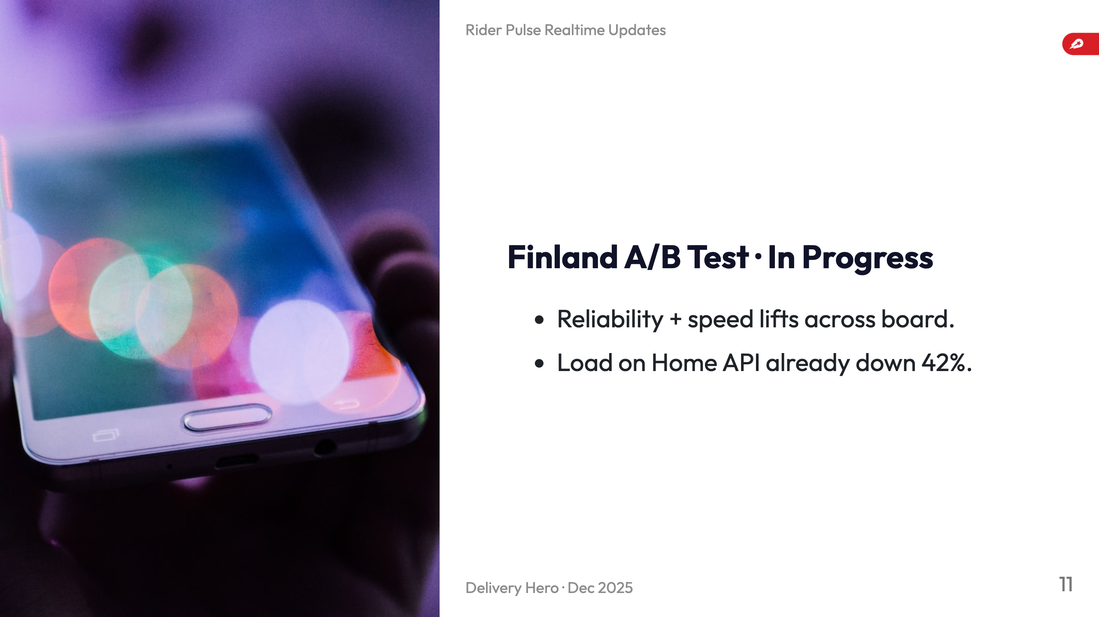
Notes:
- ICE Delivery Not Seen incidents per delivery dropped 16%; riders reach delivery screen faster. - Reaction time fell from 6.6s to 5.4s (18% faster, statistically significant). - Push acknowledgements (background) 97.5%→98.5%; delivery acknowledgement (foreground) 99.89%→99.92%. - Acceptance rate 97.54%→97.70%; reassignment 3.24%→3.03%; redispatch 0.35%→0.19%. - Rider accepting time improved 1.97%. - Client–server polling volume for Home API shrank 42%, validating realtime approach.

Slide 12
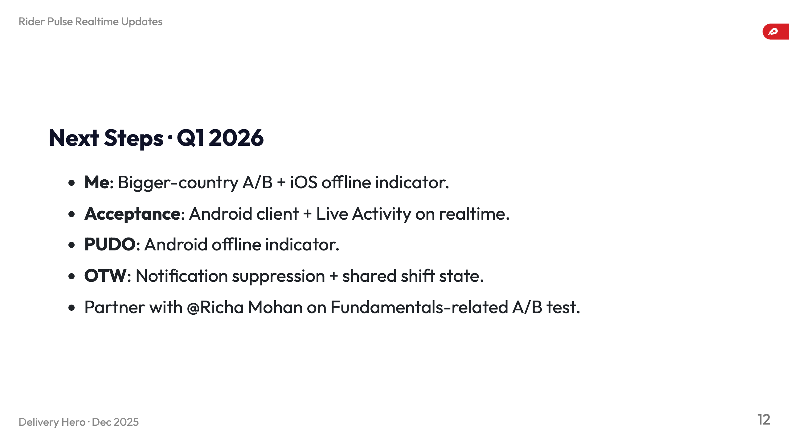
Notes:
- Run A/B in broader market to validate KPIs; build offline indicator fed by realtime presence. - Acceptance squad starts Android client with @Hakan Bagci (post Dec 22) and bases Live Activity on realtime channel. - Pick-up Drop-off squad mirrors offline indicator work on Android using same manager. - OTW: Madhav drives push suppression for connected riders and propagates shift/rider updates. - Collaboration with Richa on Fundamentals A/B once propagation is reliable.

Slide 13
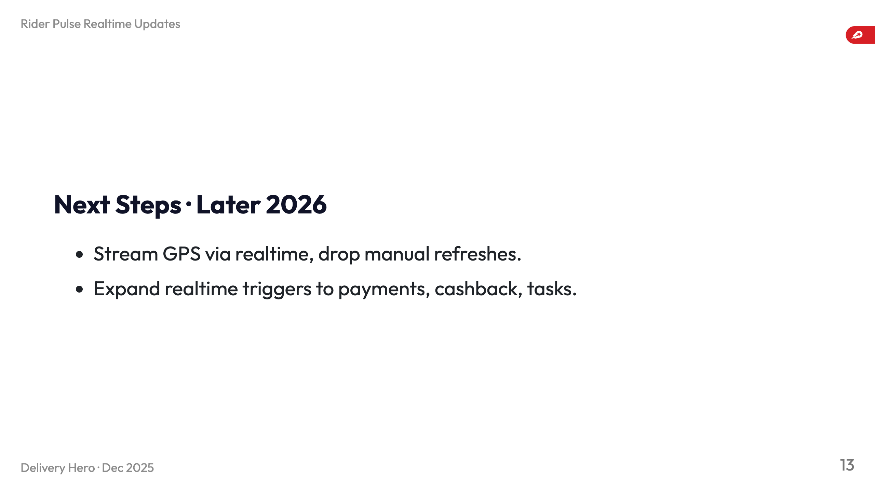
Notes:
- Location updates move onto realtime pipe to replace periodic GPS uploads and reduce ingestion cost. - Once persistent connection proves reliable, stop forcing manual refresh when foregrounding; socket becomes truth source. - Extend realtime coverage to payments, cashback, geofence tasks so squads can retire polling hacks.

Slide 14
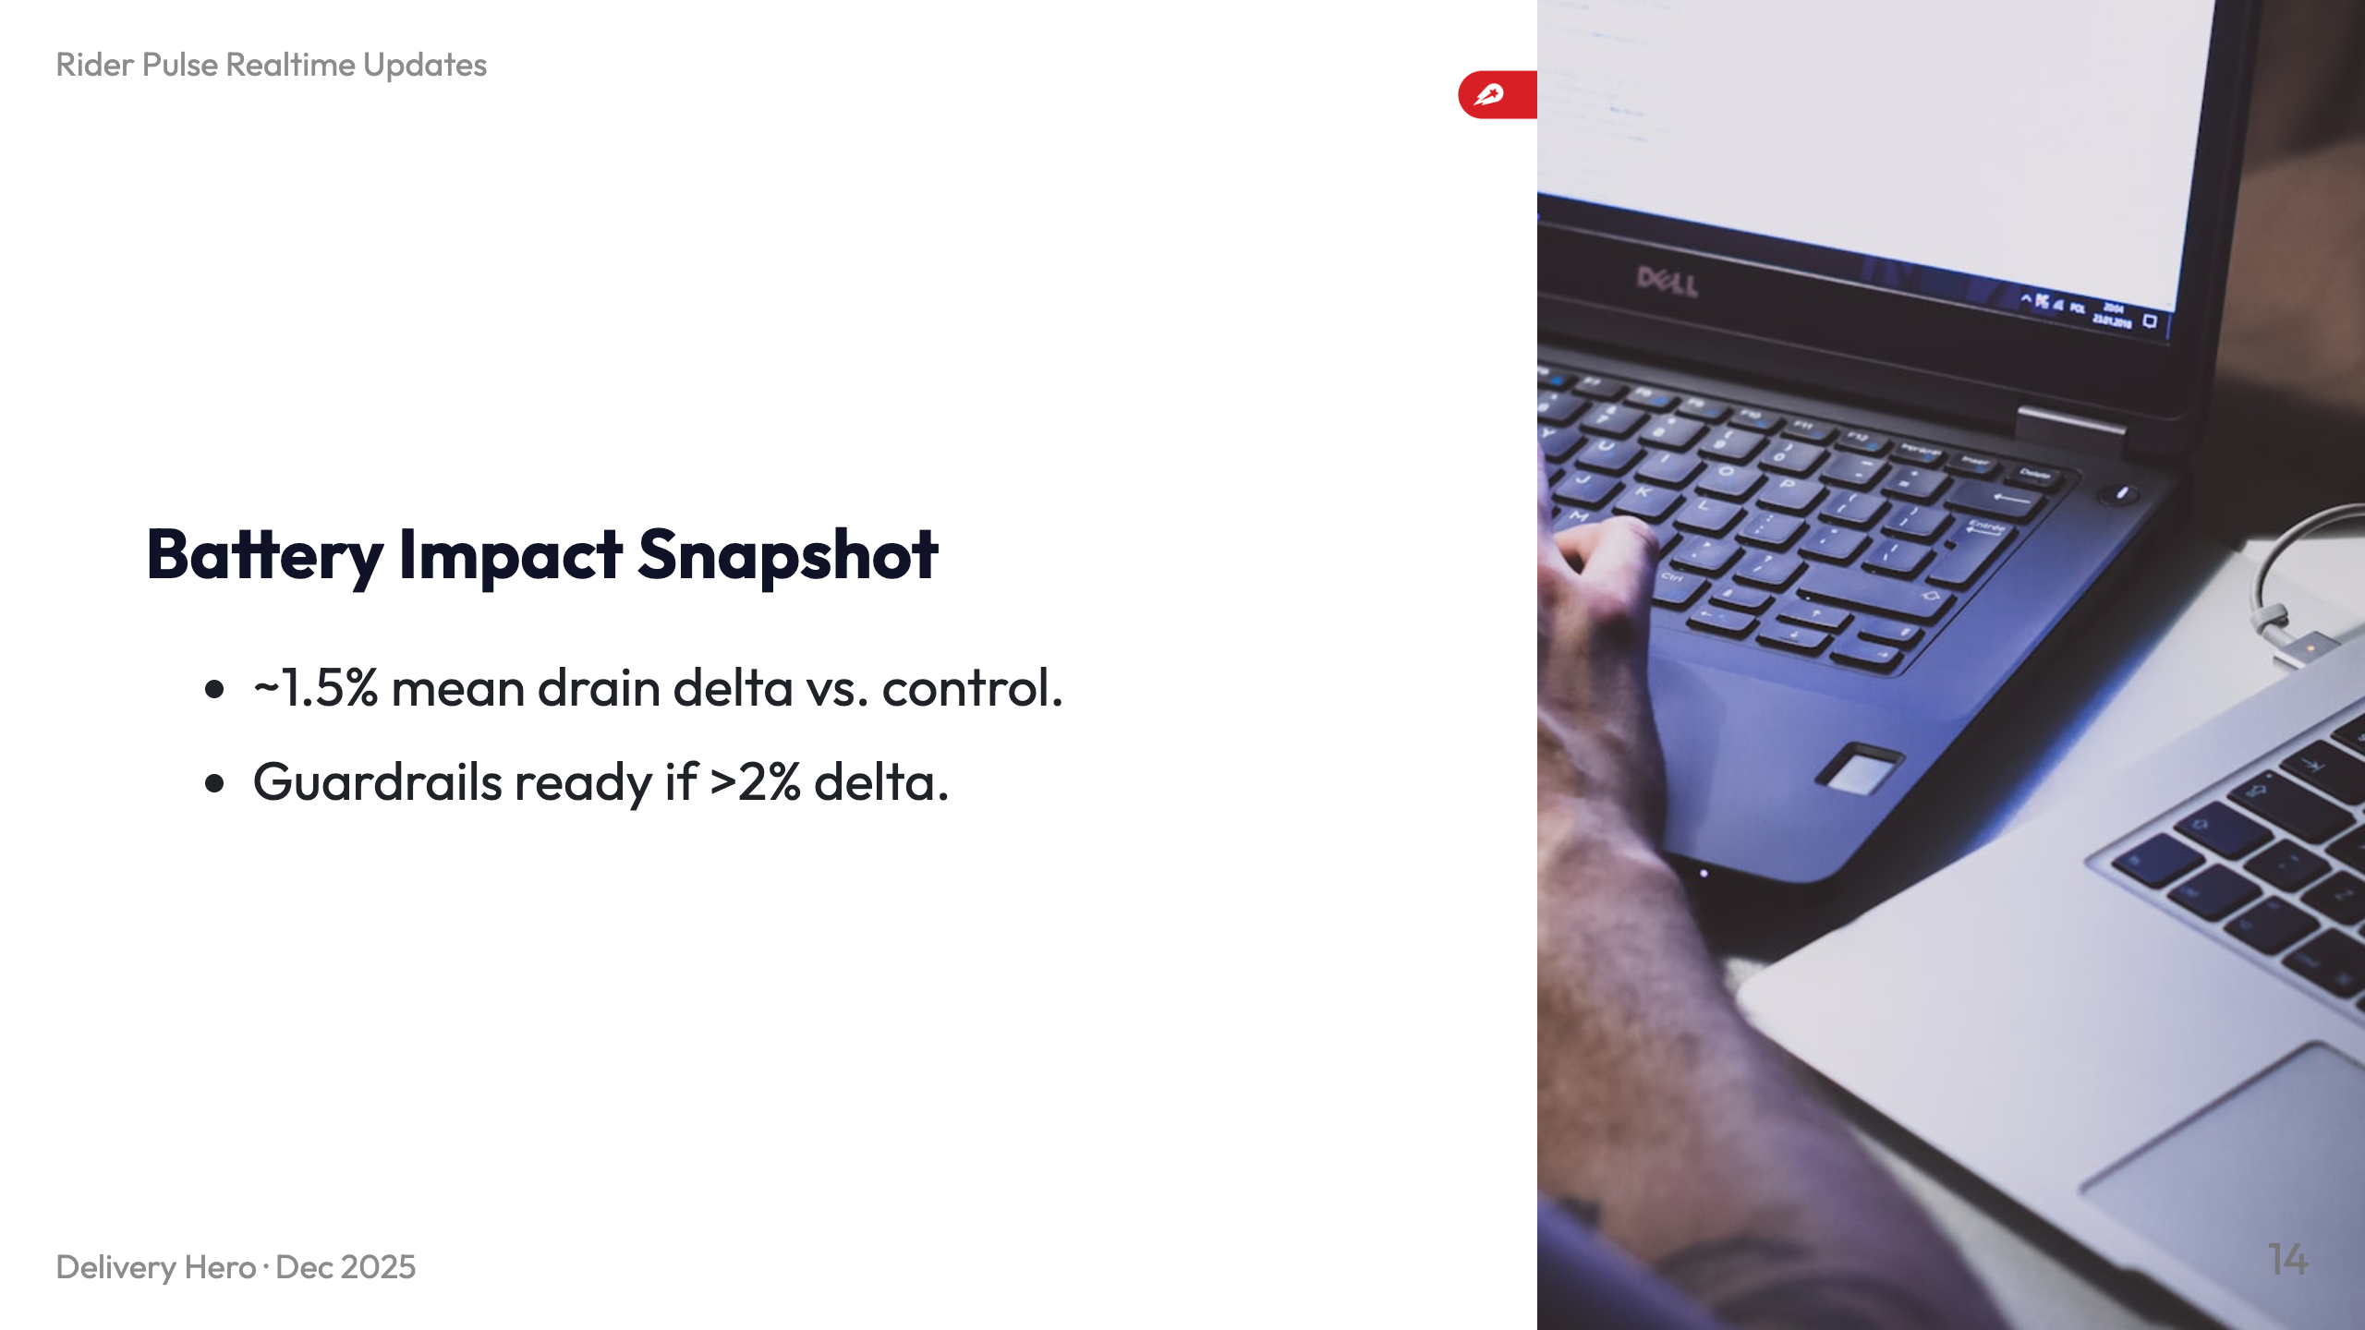
Notes:
- Analysis filtered out legacy builds and sessions with `battery_drain_den > 1`. - Increase is ~1.5% on variation; acceptable given KPI improvements but monitored closely. - Kill-switch flips back to polling if drain exceeds 2% during Finland test. - Dashboard screenshot tracks KPI + energy deltas for Rider Pulse stakeholders.

Slide 15
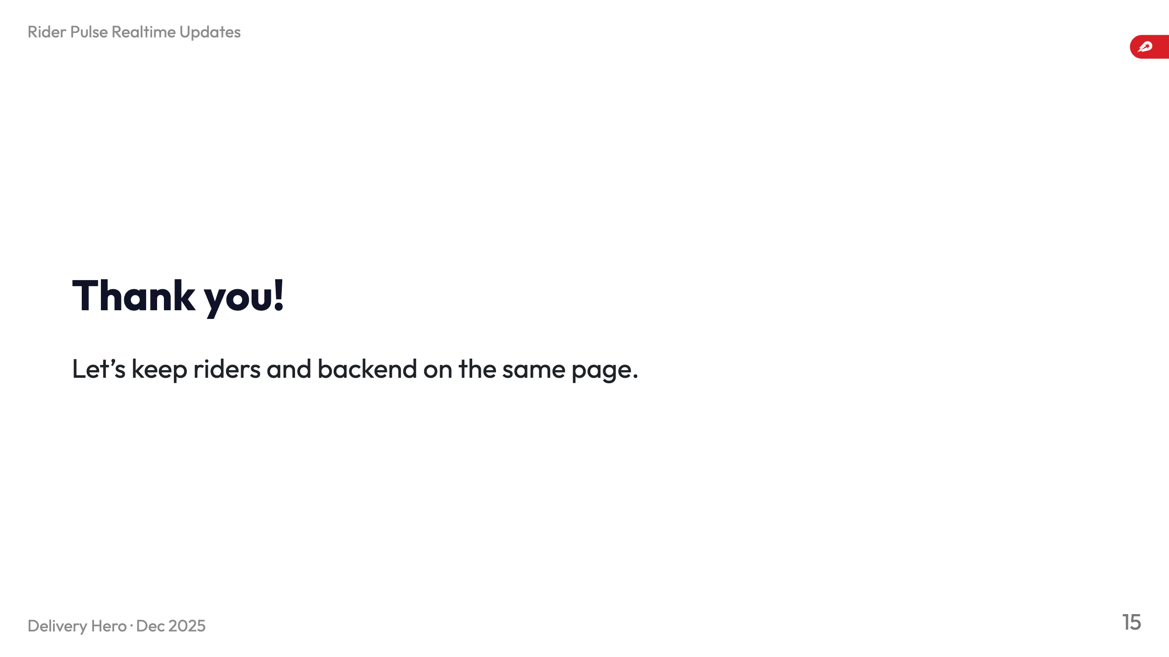
Notes:
- Invite questions on metrics, rollout, infra needs. - Reiterate call to action: expand realtime coverage and monitor A/B/battery guardrails.

